Slide 1

Project 1:
ARQ Testing in RLC (Radio Link Control)
Notes:
https://pixabay.com/illustrations/ai-generated-business-office-team-8134654/

Slide 2

Table of Contents
01
RLC
Introduction to RLC
04
Code
ARQ Process Code
02
RLC Modes
RLC Modes of Operation
05
Output
03
ARQ
ARQ Process in RLC
06
Conclusion
Notes:
https://pixabay.com/photos/teamwork-cooperation-brainstorming-3213924/

Slide 3
Group Members
Swetav
Rajeshwari
Pavan
Sujata
Prasad
Shashwat
Bhuvaneshwari
Shwetav
Rajeshwari
Pavan
3

Slide 4
Introduction to RLC
Notes:
https://pixabay.com/photos/architecture-building-ceiling-1850055/

Slide 5
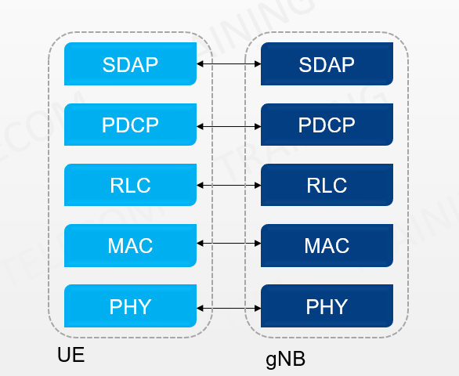
3GPP 38.322
Fig 1.1 Layer Structure
5

Slide 6
3GPP 38.322
The Radio Link Control (RLC) layer is an integral part of the protocol stack in modern mobile communication systems, such as LTE (Long-Term Evolution) and 5G NR (New Radio). Situated between the Medium Access Control (MAC) layer and the Packet Data Convergence Protocol (PDCP) layer, the RLC layer is responsible for ensuring reliable data transfer and efficient communication over the wireless link.
Radio Link Control (RLC) is a layer 2 Radio Link Protocol used in UMTS, LTE and 5G on the Air Interface. This protocol is specified by 3GPP in TS 25.322 for UMTS, TS 36.322[2] for LTE and TS 38.322 for 5G New Radio (NR). RLC is located on top of the 3GPP MAC layer and below the PDCP layer.
It is essential for adapting to the challenges of wireless communication, such as varying signal strength, interference, and mobility. By handling segmentation, error correction, and flow control, the RLC layer plays a crucial role in ensuring that data is transmitted efficiently and reliably, contributing to the overall performance and quality of service in mobile networks.

Slide 7
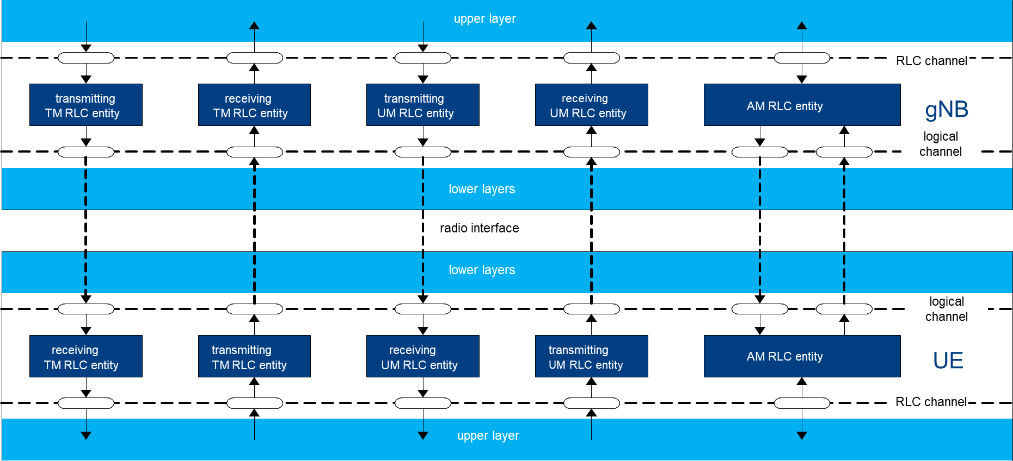
3GPP 38.322
Fig 1.2 RLC Architecture

Slide 8
Functions and Services of RLC
4.3, 4.4 of 3GPP 38.322
Functions:
transfer of upper layer PDUs
error correction through ARQ (only for AM data transfer)
segmentation and reassembly of RLC SDUs (only for UM and AM data transfer)
re-segmentation of RLC SDU segments (only for AM data transfer)
duplicate detection (only for AM data transfer)
RLC SDU discard (only for UM and AM data transfer)
RLC re-establishment;
Protocol error detection (only for AM data transfer).
Services provided to upper layers
• TM data transfer
• UM data transfer
AM data transfer, including an indication of successful delivery of upper layers PDUs.
Services provided from lower layers
Data transfer
Notification of a transmission opportunity, together with the total size of the RLC PDU(s) to be transmitted in the transmission opportunity

Slide 9
RLC Modes of Operation
Notes:
https://pixabay.com/photos/architecture-building-ceiling-1850055/

Slide 10
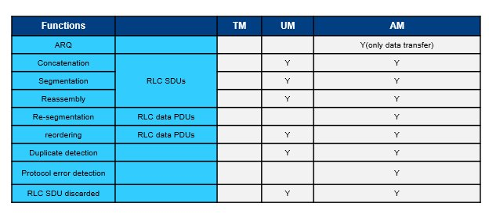
Radio Link Control Modes
4.2.1.1, 4.2.1.2, 4.2.1.3 of 3GPP 38.322
1.Transparent Mode (TM):
Do not require any error correction or
retransmission.
No RLC header is applied
Directly maps with RLC SDU to an RLC PDU
Logical Channels: BCCH, DL/UL CCCH, and
PCCH
2.Unacknowledged Mode (UM):
RLC header and sequence numbers added to
each PDU
supports segmentation, no retransmission.
Logical Channels: DL/UL DTCH
3. Acknowledged Mode (AM):
Error correction with ARQ
supports segmentation and concatenation
acknowledgments and flow control
Logical Channels: DL/UL DCCH or DL/UL DTCH
Fig 2.2 RLC Modes and its functions

Slide 11
ARQ Process in RLC
Notes:
https://pixabay.com/photos/architecture-building-ceiling-1850055/

Slide 12
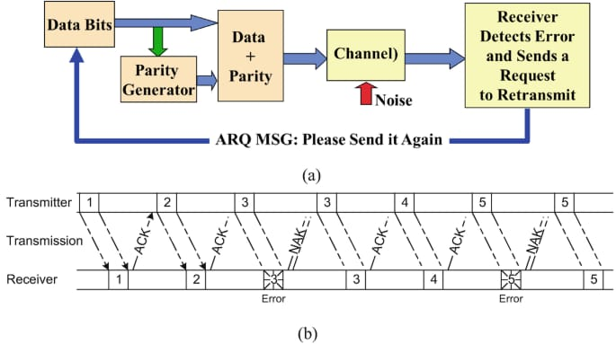
Fig 3.1 ARQ Process

Slide 13
ARQ Process
3GPP 38.322
ARQ is a protocol for error detection and correction in data communication systems. It ensures reliable data transmission by automatically requesting the retransmission of any corrupted or lost data packets
How ARQ Works in RLC:
Data Transmission:
Data is sent from the transmitter to the receiver in the form of Protocol Data Units (PDUs).
Each PDU contains a sequence number that allows the receiver to detect missing or out-of-order PDUs.
Error Detection:
The receiver checks each PDU for errors using mechanisms like Cyclic Redundancy Check (CRC).
If a PDU is received correctly, the receiver sends an acknowledgment (ACK) back to the transmitter.
Negative Acknowledgment (NACK):
If an error is detected or a PDU is missing, the receiver sends a Negative Acknowledgment (NACK) to the transmitter.
The NACK indicates that specific PDUs need to be retransmitted.
Retransmission:
Upon receiving a NACK, the transmitter resends the requested PDUs.
This process continues until the receiver successfully receives all PDUs, or until a maximum number of retransmissions is reached.

Slide 14
3GPP 38.322
Types of ARQ Mechanisms:
Stop-and-Wait ARQ:
The simplest form of ARQ.
The transmitter sends one PDU and waits for an ACK or NACK before sending the next PDU.
Pros: Simple to implement.
Cons: Inefficient for high-latency links as it leads to idle time between transmissions.
Go-Back-N ARQ:
The transmitter can send several PDUs before needing an acknowledgment.
If an error is detected, all subsequent PDUs are retransmitted, starting from the failed PDU.
Pros: Improves efficiency over Stop-and-Wait.
Cons: Can lead to significant retransmission overhead.
Selective Repeat ARQ:
Only the erroneous or missing PDUs are retransmitted.
Requires the receiver to maintain a buffer for out-of-order PDUs.
Pros: Reduces unnecessary retransmissions, improving efficiency.
Cons: More complex to implement due to the need for managing out-of-order data.

Slide 15
3GPP 38.322
Advantages of ARQ in RLC:
Reliability: Ensures that data is delivered correctly, improving the quality of service.
Error Correction: Automatically handles errors, reducing the need for manual intervention.
Efficiency: Selective Repeat ARQ, in particular, optimizes data transmission, reducing bandwidth wastage.
Dis-Advantages of ARQ in RLC:
Latency: Retransmissions can introduce delays, particularly in time-sensitive applications.
Resource Utilization: ARQ mechanisms require additional processing and memory resources, especially for Selective Repeat ARQ.

Slide 16
Code
Notes:
https://pixabay.com/photos/architecture-building-ceiling-1850055/

Slide 17
Code

Slide 18
Output
Notes:
https://pixabay.com/photos/architecture-building-ceiling-1850055/

Slide 19
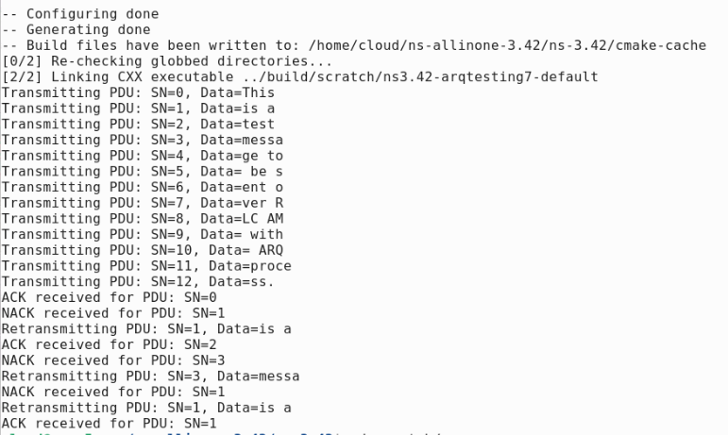
Output
Fig 4.1 Code Output

Slide 20
Code Explanation
Notes:
https://pixabay.com/photos/architecture-building-ceiling-1850055/

Slide 21
Mode (AM) with Automatic Repeat reQuest (ARQ) process. It demonstrates how segmentation of data, transmission of Protocol Data Units (PDUs), and handling of acknowledgments (ACKs) and negative acknowledgments (NACKs) work within the RLC layer, specifically in the context of ns-3, a network simulator.
Key Components and Workflow
RLC_PDU Class:
Represents a Protocol Data Unit (PDU) in the RLC layer.
Contains a sequence number (sequenceNumber) and the actual data (data).
RLC_AM Class:
Simulates the RLC Acknowledged Mode, including the ARQ mechanism.
Key data structures:
transmissionBuffer: A queue that holds PDUs waiting to be transmitted.
sentPDUs: A map that stores sent PDUs, keyed by their sequence number.
receivedACKs: A map that tracks which PDUs have been acknowledged.
retransmissionCount: A map that tracks the number of times each PDU has been retransmitted.
Key Functions in RLC_AM:
segmentAndQueueData: Segments a large data string into smaller PDUs and queues them for transmission.
transmitPDUs: Transmits PDUs from the transmissionBuffer and stores them in sentPDUs for tracking.
receiveACK: Marks a PDU as acknowledged when an ACK is received.
receiveNACK: Handles a NACK by potentially retransmitting the corresponding PDU if it hasn’t already reached the maximum retransmission limit. sendPDU: Sends a PDU and initializes its status in the tracking structures.
retransmitPDU: Retransmits a PDU if it hasn't exceeded the allowed number of retransmissions.

Slide 22
How the Program Works
Segmentation and Queuing:
The segmentAndQueueData function takes a string message and divides it into smaller segments (each of size 5 in this example), creating a RLC_PDU for each segment. These PDUs are then added to the transmissionBuffer.
2. Transmission:
The transmitPDUs function sends each PDU in the transmissionBuffer. Each PDU is recorded in the sentPDUs map, and its acknowledgment status is initially set to false.
3. Acknowledgment Handling:
When an ACK is received (receiveACK function), the corresponding PDU is marked as acknowledged.
When a NACK is received (receiveNACK function), the system checks if the PDU needs to be retransmitted based on whether it has already been acknowledged and the number of retransmissions that have occurred.
4. Retransmission:
If a PDU receives a NACK and hasn't been acknowledged or exceeded the maximum retransmissions, it is retransmitted using the retransmitPDU function.

Slide 23
Running the Program
When you run the main function:
The program segments the input string and transmits the PDUs.
It simulates the reception of ACKs and NACKs.
If necessary, PDUs are retransmitted based on the NACKs received.
The final state includes some PDUs successfully acknowledged and others retransmitted.
This example provides a good conceptual understanding of how the RLC AM with ARQ operates, focusing on key principles like segmentation, transmission, acknowledgment, and retransmission. It’s a simplified model but gives insight into the real-world mechanisms of data transmission in mobile networks.

Slide 24
Thank You!
Notes:
https://pixabay.com/photos/architecture-building-ceiling-1850055/

